Slide 1
The role of the Office for Public Counsel for Victims (OPCV): representing victims’ interests at the Court
Ludovica Vetruccio* Legal Officer - Office of Public Counsel for Victims
22 September 2022
* The views and opinions expressed are those of the authors and do not necessarily reflect the official position of the OPCV or the ICC.

Slide 2
The OPCV role and mandate
1

Slide 3
1.1 OPCV creation
Articles 68(3) and 75 RS provide for the participation of victims in the proceedings and the reparation for the harm they have suffered.
The judges of the Court considered these provisions when adopting the regulations necessary for the functioning of Court and decided to establish an office of public counsel to provide assistance to victims - directly and/or indirectly through their lawyers.
The OPCV was established on 19 September 2005 by regulation 81 of the Regulations of the Court. Since then, this regulation has been amended once, in 2011, to clarify the tasks of the Office as developed in the practice of the Court.

Slide 4
1.2 OPCV Independence
Pursuant to regulation 81(2) of the Regulations of the Court, the Office is independent and falls within the remit of the Registry only for administrative purposes.
The independence of the Office is a prerequisite for:
carrying out its mandate of assisting external legal representatives of victims and assisting and representing victims.
work without being subjected to pressure of any kind, and
preserves the privileged relationship between victims and their counsel.

Slide 5
1.3 OPCV Mandate [RoC 80-81]
Regulations 80 and 81 entrusted the Office with a mandate to:
Provide general support and assistance to the legal representatives of victims and to victims [reg. 81(4)(a) RoC]
Appear before a Chamber in respect of specific issues [reg. 81(4)(b) RoC] (e.g. OPCV request on victims in Uganda + Lubanga; TCI request on protection and victims’ scope in Lubanga)
Advance submissions on behalf of victims prior to the transmission of application forms, when application forms are pending or in the absence of a legal representative appointed [reg. 81(4)(c) RoC] (as included on 2 November 2011 < decisions in Uganda and DRC in 2007)
Act as legal representative of victims [reg. 81(4)(d) and (e) RoC] (as included on 2 November 2011) (appointed by Chamber and/or chosen by victims - rule 90(1))
Focus on two of the functions assigned to the OPCV: (i) to assist external counsels, and (ii) to represent victims

Slide 6
Regulation 81(4)(a) – Support and assistance to counsel
The Office assists counsels appointed at different stages of the proceedings, including pre-trial, trial and appeal.
The support and assistance provided to counsel includes:
Providing legal research and advice on issues related to the proceedings/rights of victims (e.g. factual background on the situations; advice on legal issues and selected aspects of international criminal law)
Providing arguments for oral or written submissions when required
Representing counsel at hearings when requested (via signature of ad hoc agreements)
Providing updated information on the law of the Court (e.g. Manual for legal representatives – available online)

Slide 7
Regulation 81(4)(e) – Assistance to and representation of victims
Since its creation in September 2005, the Office has represented or assisted in the representation of over 10.000 victims and has filed more than 1500 submissions in different proceedings before the Court.
When appointed as legal representative, the mandate of the members of the OPCV does not differ from that of legal representatives in the list of Counsel (the list of counsel is not a responsibility of the OPCV, but one of the VPRS and the Defence Support Section)
Therefore, in fulfilling their responsibilities, OPCV members enjoy the same rights and prerogatives as external legal representatives and they are bound by the same obligations - including those arising from the Code of Professional Conduct for counsel before the ICC.

Slide 8
The Office of the Public Counsel for Victims (OPCV)
Number of Victims Represented by the OPCV
Total: 6836 as of 1st June 2022

Slide 9
Models of Common Legal Representation of Victims
(1) Victims represented by external counsel | Katanga Bemba | Al Mahdi Al Hassan
(2) Victims divided in groups, some represented by OPCV and some by external counsel | Lubanga Ongwen Yekatom & Ngaïssona
(3) Victims represented by one or more OPCV counsel, assisted by field counsel | Gbagbo & Blé Goudé Ntaganda
(4) Victims represented by team composed of both OPCV and external counsel | Yekatom & Ngaïssona
(5) Victims represented by field counsel assisted by OPCV staff members in the courtroom | Ruto & Sang Kenyatta

Slide 10
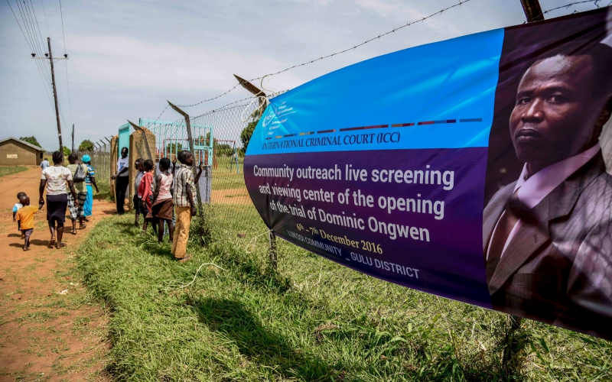
Representing Victims in a “Victim-Centered Court”

Slide 11
Thank you
Questions?

